Slide 1
Why Did Q3 Profit Dip?
A Data Story Using the Sample Superstore Datase

Slide 2
Overall Business Performance
The Sample Superstore dataset contains sales and profit information across different products, categories, regions, and time periods.
The key business question is:
Why did profit decline during Q3 despite overall sales activity?

Slide 3
Q3 2016: Profit Started to Dip
Q2 2016 Profit: $16,390
Q3 2016 Profit: $15,824
Profit decreased by approximately $567 in Q3 2016.
This raises the key question:
What caused the decline in profitability?

Slide 4
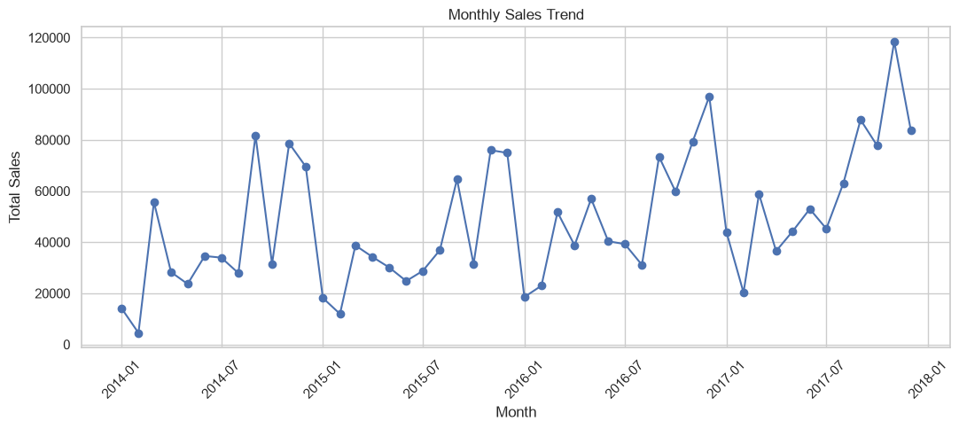
Monthly Sales Trend
• Sales fluctuate significantly across different months.
• Some months show clear peaks, while others show relatively lower sales.
• This indicates that sales performance is not consistent throughout the year.
Takeaway: Sales vary over time, so monthly performance should be monitored regularly.

Slide 5
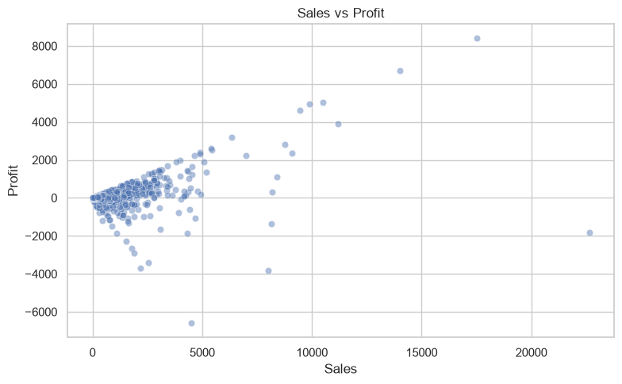
Sales vs Profit: What We Learned
Do not evaluate performance using sales alone.
Monitor profit alongside sales to identify low-profit orders and categories.
Investigate products, discounts, and regions where high sales do not translate into strong profit.
Use monthly profit tracking to identify future declines earlier.
Key takeaway: The business should focus on profitable sales, not just higher sales volume.

